Slide 1
CSE101-Lec#11
Function Call

Slide 2
Outline
Function call
Passing arguments by value
Passing arguments by reference

Slide 3
Formal Arguments and Actual Arguments
Argument: An argument is an expression which is passed to a function by its caller in order for the function to perform its task.
Actual arguments: The arguments that are passed in a function call are called actual arguments. These arguments are defined in the calling function.
Formal arguments: The formal arguments are the parameters/arguments in a function declaration. Formal arguments are a copy of the actual arguments.
Notes:
called "parameters" because they define information that is passed to a function.

Slide 4
#include <stdio.h>
void sum(int i, int j, int k); /*function prototype*/
int main()
{
int a = 5;
sum(3, 2 * a, a); // actual arguments
return 0;
}
void sum(int i, int j, int k)//formal arguments
{
int s;
s = i + j + k;
printf("sum is %d", s);
}

Slide 5
Methods of passing arguments
There are two ways to call a function/to pass arguments to a function:
Call by value
Call by reference

Slide 6
Call by Value
Call by value
In this method the values of actual arguments are copied to the formal arguments of the function.
Changes in function do not effect original
Use when function does not need to modify argument
Avoids accidental changes
The method of passing arguments by value is know as call by value

Slide 7
#include <stdio.h>
int cubeByValue(int n); // prototype
int main( void )
{
int number = 5; // initialize number
printf("The original value of number is %d", number);
cubeByValue(number); // pass number by value
printf( "\nThe new value of number is %d\n", number );
} // end main
int cubeByValue( int n )
{
return n*n*n; //cube local variable n and return value
}
The original value of number is 5
The new value of number is 5

Slide 8
Call by reference
The address of actual argument are copied to the formal arguments.
The called function uses the address to refer to the actual location.
Changes made by the function are effective when the control returns to the calling function.
If we want to make changes even in the actual arguments, then we use call by address
Notes:
We have also learnt that variables are stored somewhere in memory. So instead of passing the value of a variable, can we not pass the location number (also called address) of the variable to a function? If we were able to do so it would become a ‘call by reference’.

Slide 9
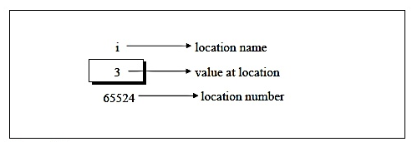
Address of variable
int i=3;
If we want to print the address of variable:
#include< stdio.h>
void main()
{
int i=3;
printf(“address of i=%d”, &i);
printf(“value of i =%d”, i);
}
Notes:
Address = 65524
Value = 3

Slide 10
Pointers
A variable which stores address of another variable
Example:
int *p;
int i;
p= &i;
*p gives value at address stored in p.
int *p means p is containing an address of variable on which an integer is stored

Slide 11
Calling Functions by Reference
Call by reference with pointer arguments
Pass address of argument using & operator
Allows you to change actual location in memory
* operator
Used as alias/nickname for variable inside of function
void double( int *number )
{
*number = 2 * ( *number );
}
*number used as nickname for the variable passed

Slide 12
#include <stdio.h>
void cubeByReference(int *nPtr); //function prototype
int main( void )
{
int number = 5;
printf("The original value of number is %d", number);
cubeByReference( &number ); //pass address of number
printf("\nThe new value of number is %d\n", number);
} // end main
//calculate cube of *nPtr; actually modifies number in main
void cubeByReference( int *nPtr )
{
*nPtr = *nPtr * *nPtr * *nPtr; //cube *nPtr
}z
The original value of number is 5
The new value of number is 125

Slide 13
#include <stdio.h>
void fn1(int a){
printf("%d",a);
return a*a;
}
int main()
{
int a=5;
fn1(a);
printf("%d",a);
}
1. 5 25
2. 25 25
3. 25 5
4. 5 5

Slide 14
#include <stdio.h>
int show();
void main()
{
int a;
a=show();
printf("%d", a);
}
int show()
{
return 15.5;
return 35;
}
1. 15.5
2. 15
3. 35
4. error

Slide 15
#include <stdio.h> 1. -5
void f1 (int a, int b) 2. 5
{ 3.-3
int c; 4. Compilation error
c=a; a=b; b=c;
}
void f2 (int *a, int *b)
{
int c;
c=*a; *a=*b;*b=c;
}
int main()
{
int a=4, b=5, c=6;
f1(a, b);
f2(&b, &c);
printf ("%d", c-a-b);
return 0;
}

Slide 16
#include <stdio.h>
void show(int x,int y)
{
x=x+1;
y=y+1;
printf(“%d,%d ",x,y);
}
int main()
{
int a=6,b=9;
show(a,b);
a=a+1;
b=b+1;
printf(“%d,%d ",a,b);
}
A. 7,10 8,11
B. 7,10 7,10
C.8,11 7,10
D. Compiler error

Slide 17
#include <stdio.h>
void show(int *x,int *y)
{
*x=*x+1;
*y=*y+1;
printf(“%d,%d ",*x,*y);
}
int main()
{
int a=6,b=9;
show(&a,&b);
a=a+1;
b=b+1;
printf(“%d,%d ",a,b);
}
A. 7,10 8,11
B. 7,10 7,10
C.8,11 7,10
D. Compiler error

Slide 19

Header Files
Header files
Contain function prototypes for library functions
<stdlib.h> , <math.h> , etc
Load with #include <filename>
#include <math.h>
Custom header files
Create file with functions
Save as filename.h
Load in other files with #include "filename.h"
Reuse functions
Example #include<square.h>
Quick yak:
Students should create their header files for:
GeoMaster
MyCarRace
MyCalc

Slide 20
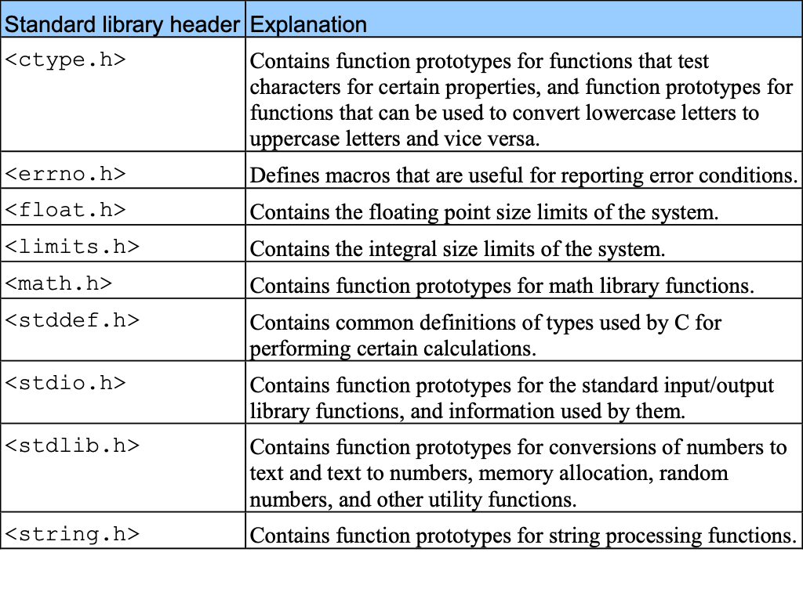
Header Files

Slide 21
Next Class: Recursive Functions and Scope Rules

